Slide 1
Virtual Memory
The physical main memory is not as larger as the address space spanned by an address issued by the processor.
Example: 32-bit address allows an address space of 4G bytes, but main memory may only be a few hundred megabytes.
When a program does not completely fit into the main memory, the parts of it not currently being executed are stored on secondary storage devices, such as disks.
All parts of a program that are eventually executed are first brought into the main memory.
When a new segment of a program is to be moved into a full memory, it must replace another segment already in the memory.

Slide 2
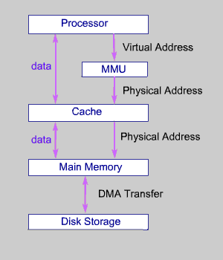
Virtual memory organization

Slide 3
Techniques that automatically move program and data blocks into the physical main memory when they are required for execution are called virtual-memory techniques.
The binary addresses that the processor issues for either instructions or data are called virtual or logical addresses. These addresses are translated into physical addresses by a combination of hardware and software components.
If a virtual address refers to a part of the program or data space that is currently in the physical memory, then the contents of the appropriate location in the main memory are accessed immediately.
If the referenced address is not in the main memory ,its contents must be brought into a suitable location in the memory before they can be used.

Slide 4
A special hardware unit ,called Memory Management Unit(MMU) translates virtual addresses into physical addresses.
If the desired data or instructions are in the main memory they are fetched.
If the desired data or instructions are not in the main memory, MMU causes the operating system to bring the data from the secondary storage into the main memory.

Slide 5
Address translation
Address Translation is done by two techniques
Paging
Segmentation
Paging
A simple method for translating virtual addresses into physical addresses is to assume that all program and data are composed of fixed-length units called pages. A page consists of a block of words that occupy contiguous locations in the main memory.
Page is a basic unit of information that is transferred between secondary storage and main memory.
Size of a page commonly ranges from 2K to 16K bytes.

Slide 6
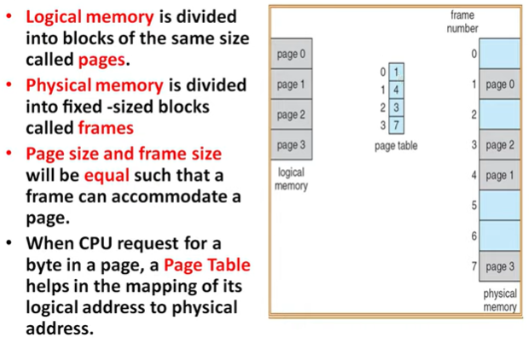
(RAM)

Slide 7
Pages should not be too small, because the access time of a magnetic disk is much longer than the access time of the main memory.
The reason for this is that it takes a considerable amount of time to locate the data on the disk, but once located, the data can be transferred at a rate of several megabytes per second.
If pages are too large it is possible that a substantial portion of a page may not be used, yet this unnecessary data will occupy valuable space in the main memory.
The cache bridges the speed gap between the processor and the main memory and is implemented in hardware.
The virtual-memory mechanism bridges the size and speed gaps between the main memory and secondary storage and is usually implemented in part by software techniques.

Slide 8
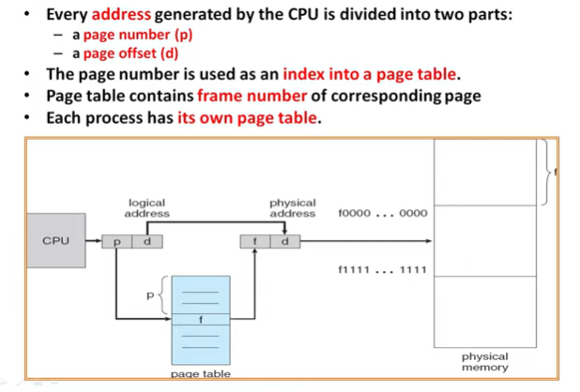

Slide 9
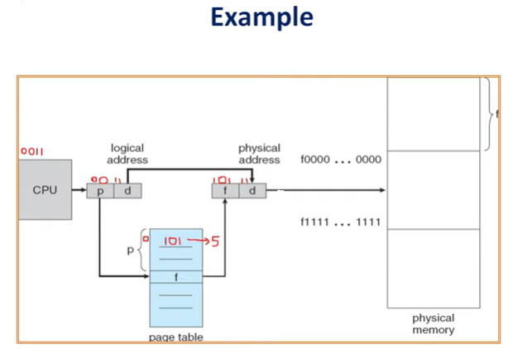

Slide 10
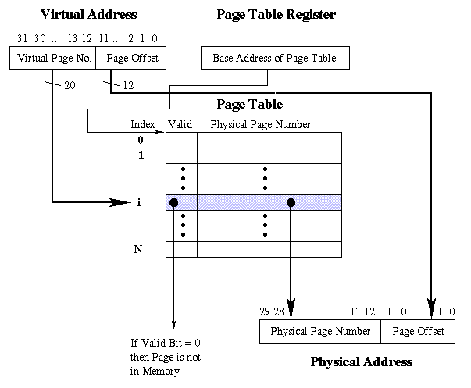
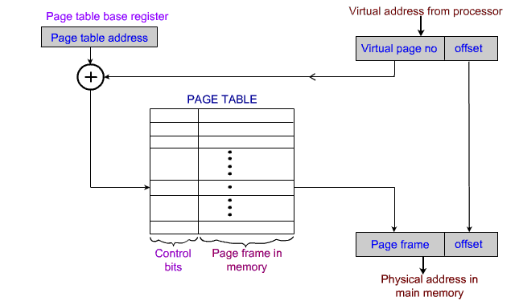
Virtual Memory Address translation

Slide 11
A virtual memory address translation method based on the concept of fixed length pages.
Each virtual address generated by the processor, whether it is for an instruction fetch or an operand fetch/store operation, is interpreted as a virtual page number(high-order bits)followed by an offset (low-order bits) that specifies the location of a particular byte(or word) within a page.
Information about the main memory location of each page is kept in a page table.
This information includes the main memory address where the page is stored and the current status of the page.
An area in the main memory that can hold one page is called a page frame.

Slide 12
The starting address of the page table is kept in a page table base register.
This provides the address of the corresponding entry in the page table.
The contents of this location in the page table give the starting address of the page if the page is currently in the main memory.
Page table entry for a page also includes some control bits which describe the status of the page while it is in the main memory.
One bit indicate the validity of the page, that is, whether the page is actually loaded in the main memory.
Another bits indicates whether the page has been modified during its residency in the memory.
Other control bits indicate various restrictions that may be imposed on accessing the page.

Slide 13
The page table information is used by the MMU for every read and write access; so ideally, the page table should be situated within the MMU.
The page table may be rather larger, and since the MMU is normally implemented as part of the processor chip, it is impossible to include a complete page table on this chip.
Therefore, the page table is kept in the main memory.
However, a copy of a small portion of the page table can be accommodated within the MMU.
A small cache called as Translation Lookaside Buffer (TLB) is included in the MMU.
TLB holds page table entries of the most recently accessed pages.
In addition to the above for each page, TLB must hold the virtual page number for each page.

Slide 14
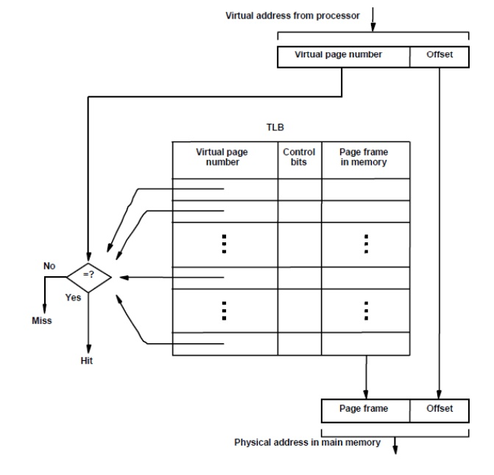
Figure shows a possible organization of a TLB where the associative-mapping technique is used.

Slide 15
Address translation proceeds as follows:
Virtual address generated by the processor, the MMU looks in the TLB for the referenced page.
If the page table entry for this page is found in the TLB, the physical address is obtained immediately.
If there is a miss in the TLB, then the required entry is obtained from the page table in the main memory and the TLB is updated.
if a program generates an access to a page that is not in the main memory, a page fault is occur.

Slide 16
Upon detecting a page fault by the MMU, following actions occur:
MMU asks the operating system to intervene by raising an exception(interrupt).
Processing of the active task which caused the page fault is interrupted.
Control is transferred to the operating system.
Operating system copies the requested page from secondary storage to the main memory.
Once the page is copied, control is returned to the task which was interrupted.

Slide 17
If a new page is brought from the disk when the main memory is full, it must replace one of the resident pages.
The problem of choosing which page to remove is just as critical here as it is in a cache, and the idea that programs spend most of their time in a few localized areas also applies.
Because main memories are considerably larger than cache memories, it should be possible to keep relatively larger portions of a program in the main memory.
This will reduce the frequency of transfers to and from the disk.

Slide 18
Concepts similar to the FIFO, Optimal and LRU replacement algorithms can be applied to page replacement and the control bits in the page table entries can indicate usage.
One simple scheme is based on a control bit that is set to 1 whenever the corresponding page is referenced (accessed).
The operating system occasionally clears this bit in all page table entries, thus providing a simple way of determining which pages have not been used recently.
A modified page has to be written back to the disk before it is removed from the main memory.
It is important to note that the write-through protocol, which is useful in the framework of cache memories, is not suitable for virtual memory.

Slide 19
The address translation process in the MMU requires some time to perform, mostly dependent on the time needed to look up entries in the TLB.
Because of locality of reference, it is likely that many successive translations involve addresses on the same page. This is particularly evident in fetching instructions.
Thus, we can reduce the average translation time by including one or more special registers that retain the virtual page number and the physical page frame of the most recently performed translations.
The information in these registers can be accessed more quickly than the TLB.

Slide 20
What is Segmentation?
Segmentation is a technique of memory management. It is just like the Paging technique except the fact that in segmentation, the segments are of variable length but, in Paging, the pages are of fixed size. In segmentation, the memory is split into variable-length parts. Each part is known as segments. The information which is related to the segment is stored in a table which is called a segment table.
There are two types of information stored in the segment table:
Limit
Base
Limit: – The limit is the length or size of the segment
Base: – The base is the base address of the segment.

Slide 21
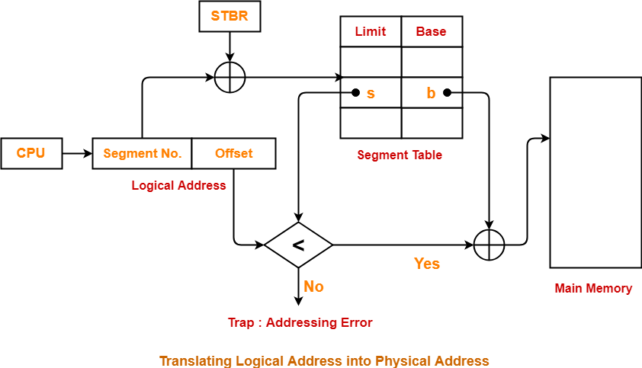

Slide 22
Translation of logical Address into physical Address
As a CPU always generates a logical address and we need a physical address for accessing the main memory. This mapping is done by the MMU(memory management Unit) with the help of the segment table.
Lets first understand some of the basic terms then we will see how this translation is done.
Logical Address: The logical address consists of two parts segment number and page offset.
1. Segment Number: It tells the specific segment of the process from which the CPU wants to read the data.
2. Segment Offset: It tells the exact word in that segment which the CPU wants to read.

Slide 23
Logical Address = Segment Number + Segment Offset
Physical Address: The physical address is obtained by adding the base address of the segment to the segment offset.
Segment table: A segment table stores the base address of each segment in the main memory. It has two parts i.e. Base and Limit. Here, base indicates the base address or starting address of the segment in the main memory. Limit tells the size of that segment. A register called Segment Table Base Register(STBR) which holds the base value of the segment table. The segment table is also stored in the main memory itself.

Slide 24
How is the translation done?
The CPU generates the logical address which contains the segment number and the segment offset. STBR register contains the address of the segment table. Now, the segment table helps in determining the base address of the segment corresponding to the page number. Now, the segment offset is compared with the limit corresponding to the Base. If the segment offset is greater than the limit then it is an invalid address. This is because the CPU is trying to access a word in the segment and this value is greater than the size of the segment itself which is not possible. If the segment offset is less than or equal to the limit then only the request is accepted. The physical address is generated by adding the base address of the segment to the segment offset.

